Slide 1

Visual Basic.NET Introduction

Slide 2
ROAD MAP
Introduction
Designing Windows Controls
Enhancing Existing Controls
Building Compound Controls
Building User-Drawn Controls
Designing irregular controls
Owner-Drawn Controls

Slide 3
Introduction
To design custom Windows controls for .NET
how to build custom controls that combine multiple .NET control
Compound controls
To build user-drawn controls

Slide 4
Designing Windows Controls
Standard application
a main form
several (optional) auxiliary forms
interacts with the user through its interface
design of a Windows control
similar to the design of a form
place controls on a Form-like object (UserControl), which is the control’s surface
a custom control is an application with a visible user interface as well as an invisible programming interface
manipulate the control
At design/ run time

Slide 5
Enhancing Existing Controls
The .NET Windows controls are quite functional,
Example: TextBox control
Customize appearance: change its color/ contents/ control formats
The best approach is to create a new Windows control with all the desired functionality and then reuse it in multiple projects

Slide 6
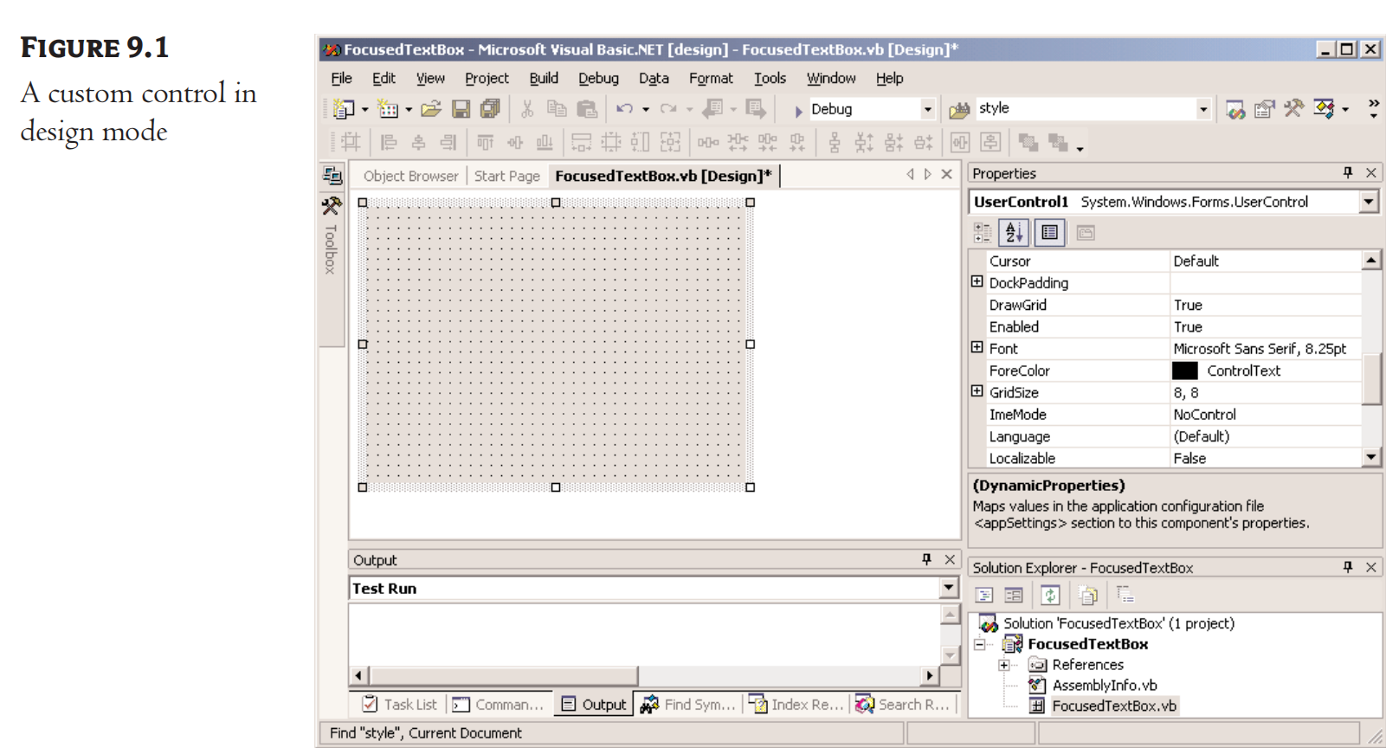
Building the FocusedTextBox Control
Call our new custom control FocusedTextBox
Start a new VB project
On the New Project dialog box
select the template Windows Control Library
Name the project FocusedTextBox.

Slide 7
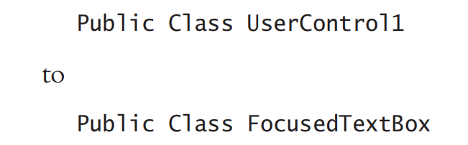
Building the FocusedTextBox Control
Rename the UserControl1 object to FocusedTextBox
Rename the class

Slide 8
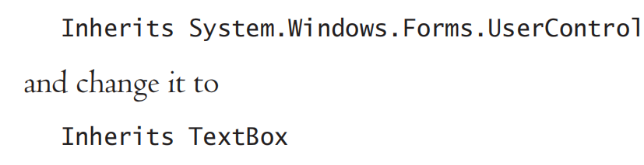
Building the FocusedTextBox Control
Inherit all the functionality of the TextBox control

Slide 9
Building the FocusedTextBox Control
To test the control, place an instance of the custom control on the Form1 form of the test project
build the control
add a reference to this control to the test project
Select the FocusedTextBox item in the Solution Explorer
select the Build FocusedTextBox command

Slide 10
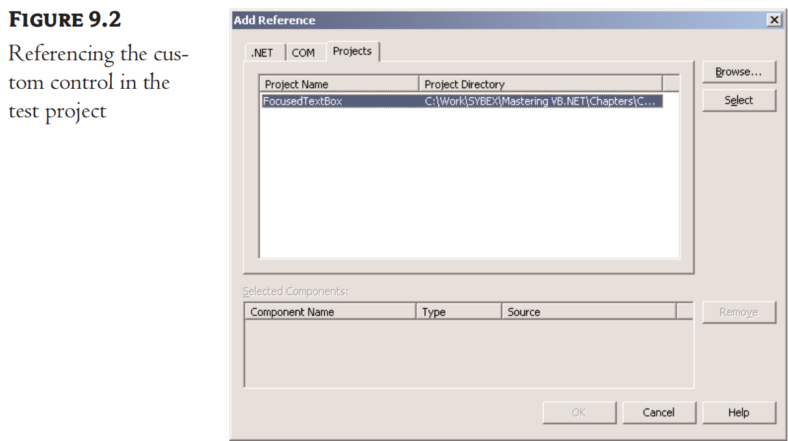
Building the FocusedTextBox Control
Switch to the test project
and select the Project
Add Reference command
switch to the Projects tab
Your new control is now
referenced in the test project

Slide 11
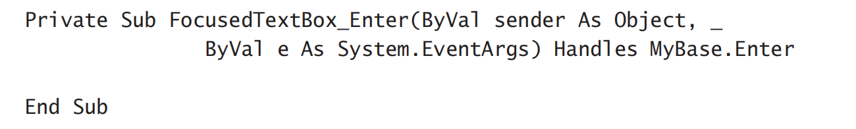

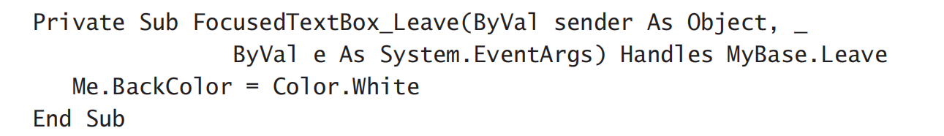
Building the FocusedTextBox Control
Add some extra functionality to our custom TextBox control

Slide 12
overview of the control’s custom properties
EnterFocusColor
When the control receives the focus, its background color is set to this value
LeaveFocusColor
When the control loses the focus, its background color is set to this value
Mandatory
This property indicates whether the control corresponds to a required field, if Mandatory is True (Required), or an optional field, if Mandatory is False (Optional)
MandatoryColor
This is the background color of the control if its Mandatory property is required

Slide 13
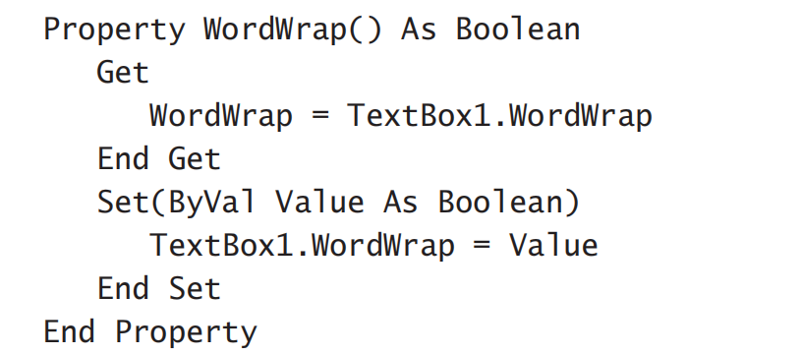
Building Compound Controls
compound control
A visible interface that combines multiple Windows controls
Doesn’t inherit the functionality of any specific control
Must expose its properties by providing your own code

Slide 14

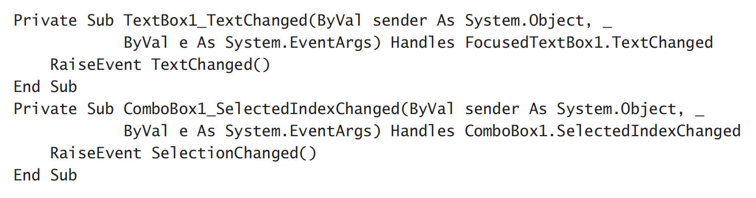
Building Compound Controls
When your compound control contains a TextBox and a ComboBox control
To raise the TextChanged event when the user edits the TextBox control and the (custom) SelectionChanged event
when the user selects another item in the ComboBox control

Slide 15
Building User-Drawn Controls
A user-drawn control
consists of a UserControl object with no constituent controls
Updating the control’s visible area with the appropriate code, which must appear in the control’s OnPaint method
called right before the OnPaint event is fired
if you override it, you can take control of the repaint process

Slide 16
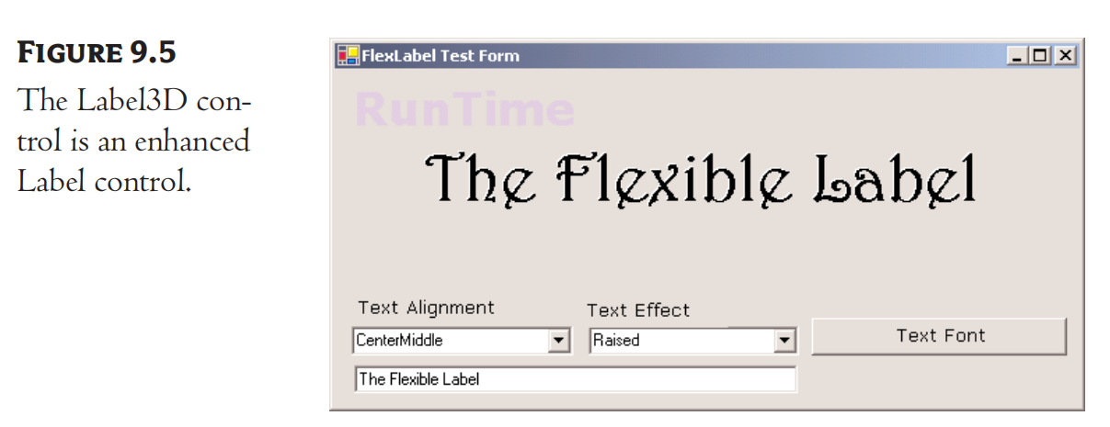
Building User-Drawn Controls
Develop the Label3D control
an enhanced Label control
Provide all the members of the Label control plus a few highly desirable new features
the ability to align the text in all possible ways on the control, as well as in three-dimensional type
New Custom Control: Label 3 D
the FlexLabel project
the Label3D project & the usual test project

Slide 17
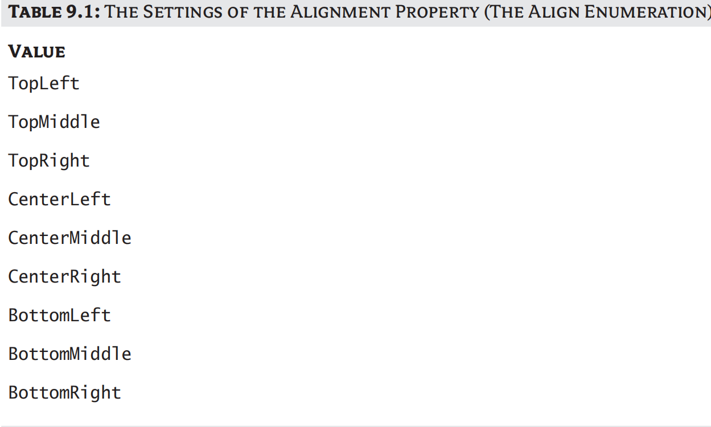
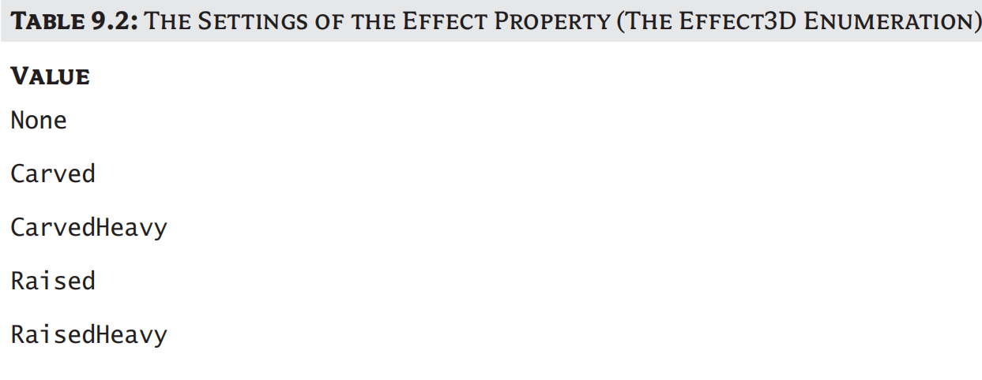
The Label3D Control’s Specifications
Label 3D Control
Must provide the Caption and Font properties
Align its caption both vertically and horizontally

Slide 18
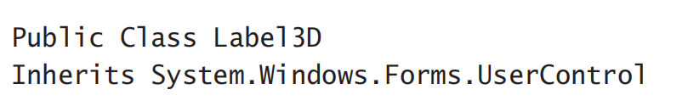
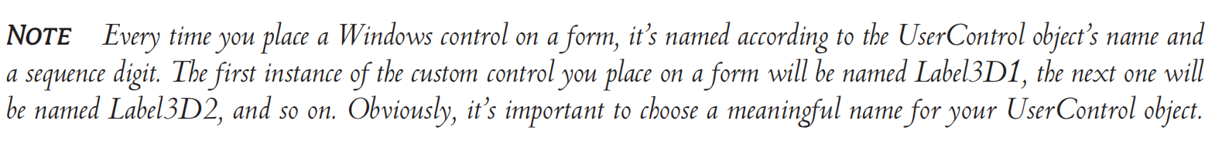
Designing the Custom Control
New Project: FlexLabel
Rename the UserControl1 object to Label3D

Slide 19
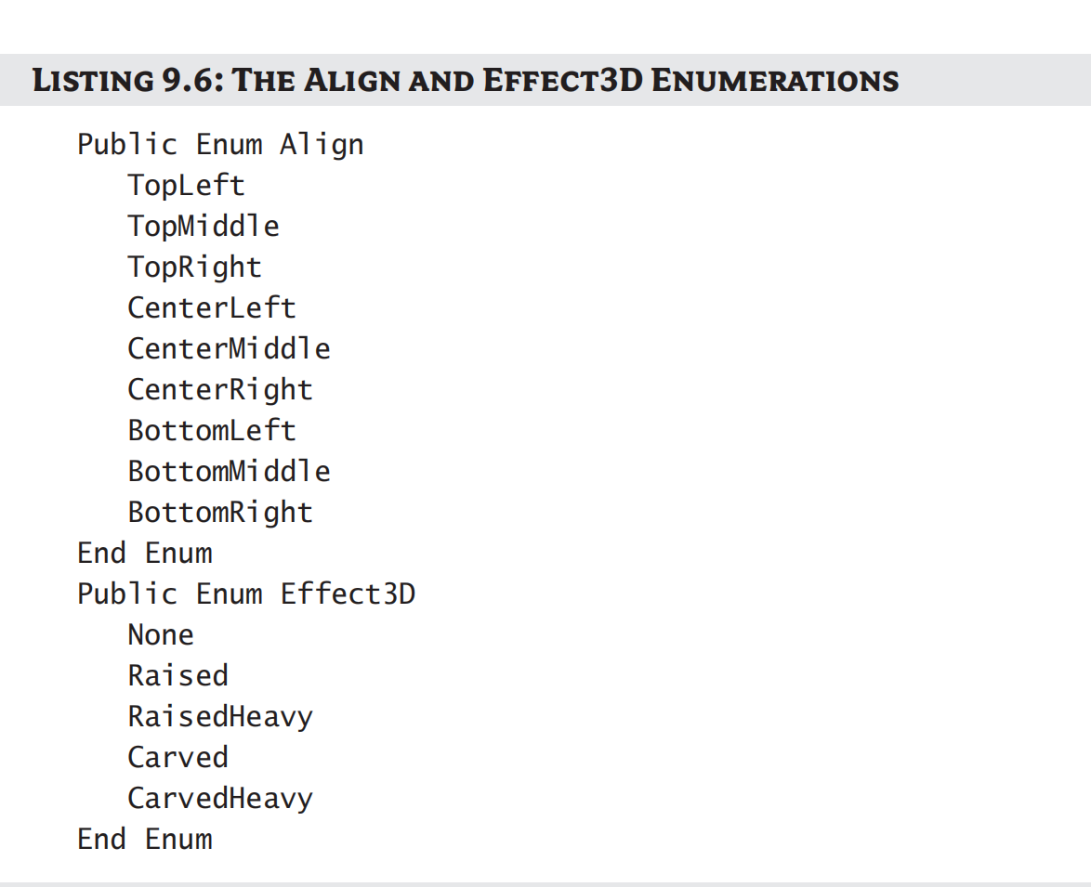
Designing the Custom Control
The Enum statements for the
two enumerations

Slide 20
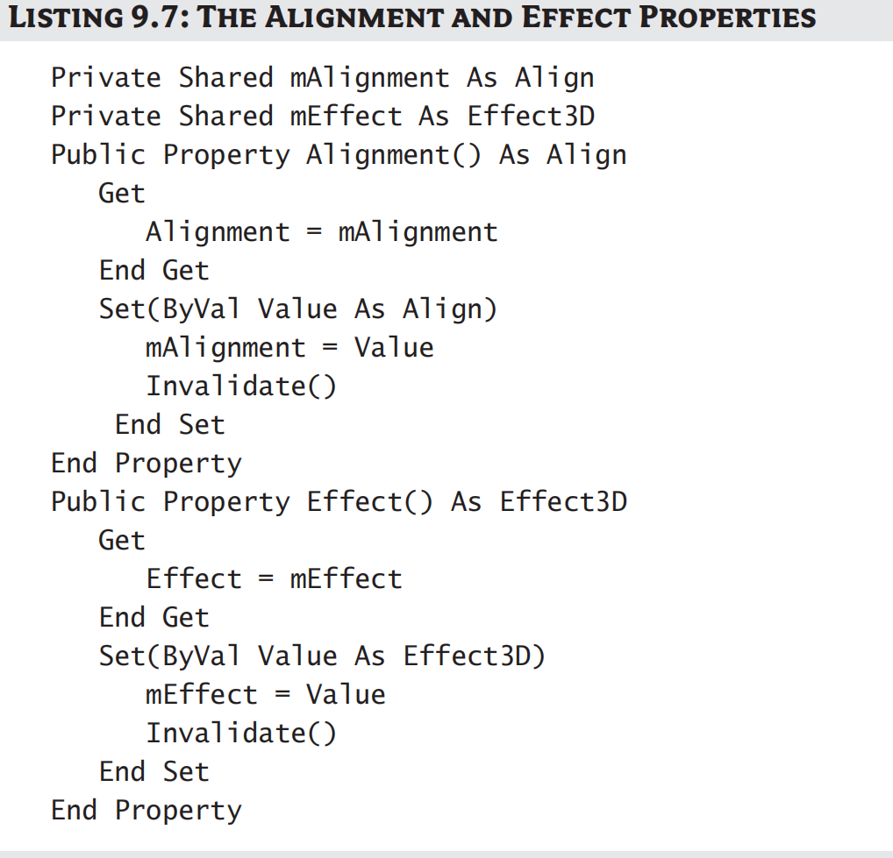
Designing the Custom Control
To implement the Alignment
and Effect properties

Slide 21
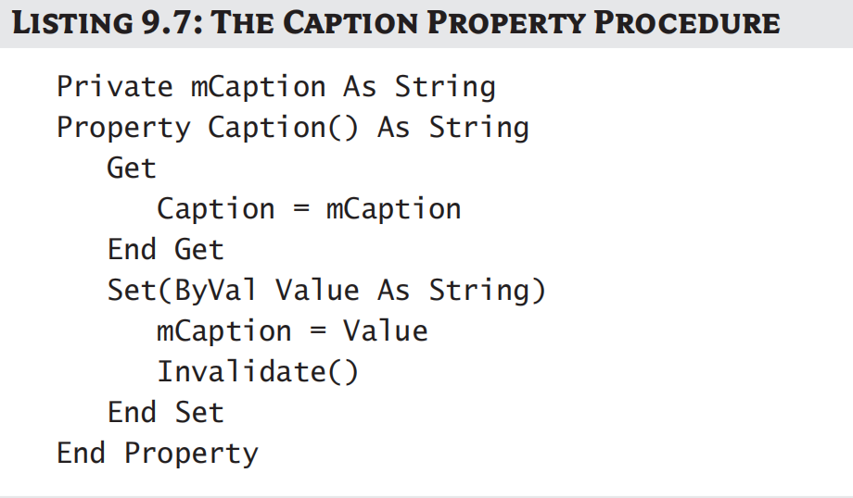
Designing the Custom Control
To implement the Caption property

Slide 22
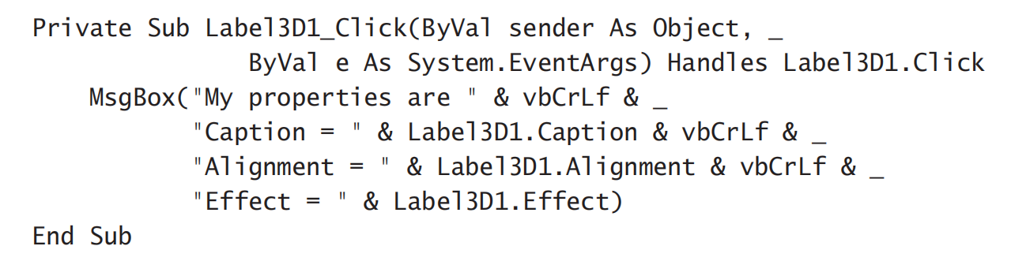
Test your New Control
first add it to the Toolbox
Add the TestProject to the current solution
And Rename its Form to TestForm

Slide 23
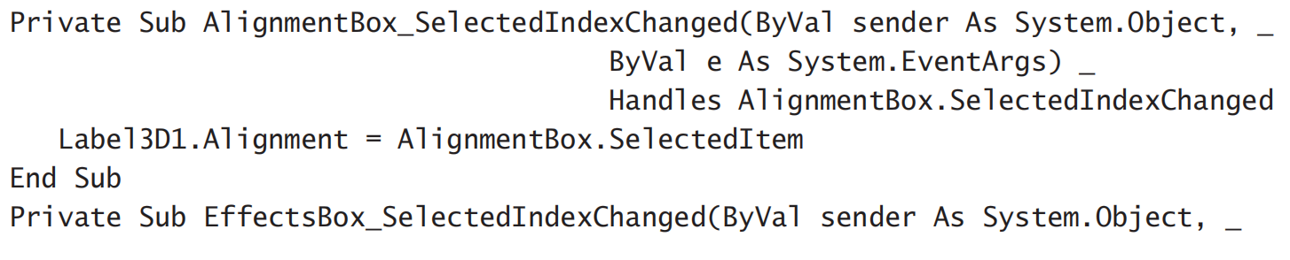
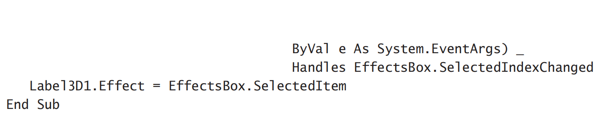
Test your New Control
set the corresponding property to the selected value

Slide 24
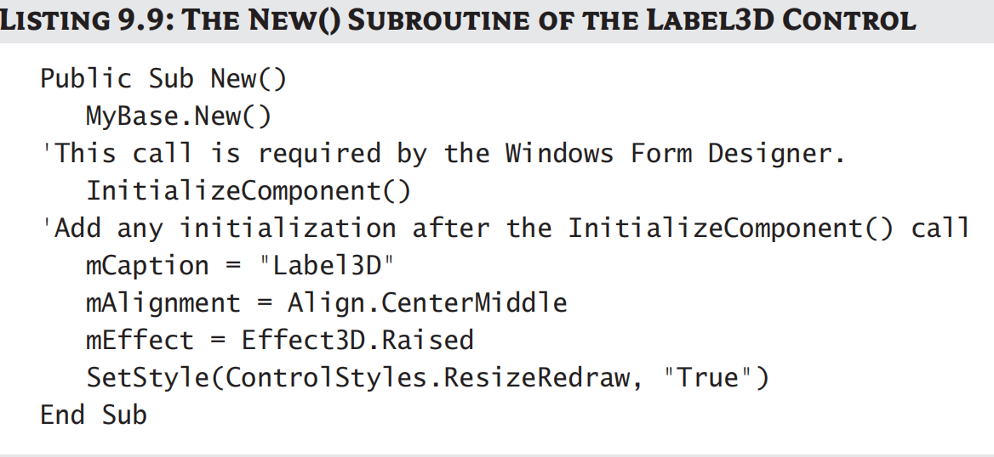
Initializing a Custom Control
insert the appropriate code in the New() subroutine

Slide 25
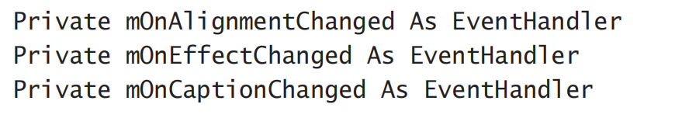
The Changed Events
Declare an event handler for each of the Changed events

Slide 26
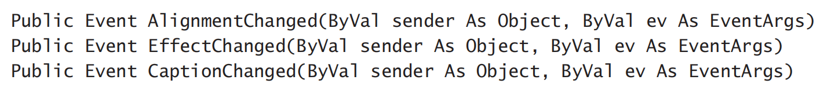
The Changed Events
Then declare the actual events and their handlers

Slide 27
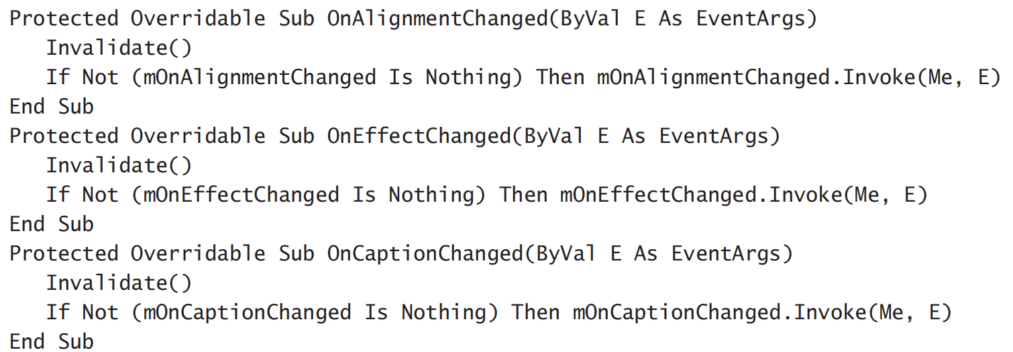
The Changed Events
finally invoke the event handlers from within the appropriate OnEventName method

Slide 28
Exercise
(1) What does “TopLeft” mean in the setting of the Effect property?
(2) What does “Carved” mean in the setting of the Effect property?

